Slide 1
Scouting America
Leave No Trace Instructor Course

Slide 2
Leave No Trace Resources

Slide 3
Objectives
As a result of this session, each participant should be able to:
Discuss resources available from Leave No Trace.
Discuss resources available from Scouting America
Discuss resources available on the scouting.org website.
https://www.scouting.org/outdoor-programs/outdoor-ethics/
https://scouting.org/outdoor-programs/outdoor-ethics/resources
Discuss resources available from outside suppliers.
Review “starter kit” materials supplied by course (if any).
Notes:
Describe the objectives.

Slide 4

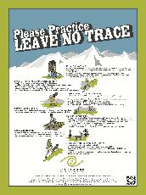
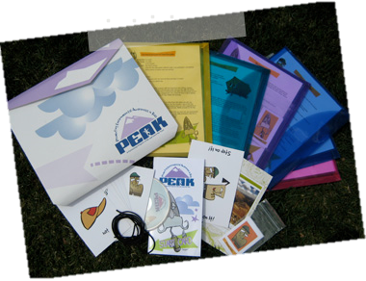


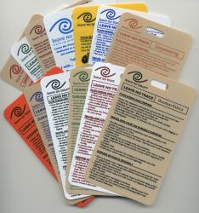
Resources from Leave No Trace
Leave No Trace 101 Online
Level 2 Instructor Handbook
Skills and Ethics Books
Brochures
PEAK Vol 2. & Additional Modules
Hang Tags
Posters
Tips and Best Practices
Notes:
Table display of these resources to accompany this presentation works well.
Remind participants that as instructors, they have a responsibility to use the most current and correct information. Using primary sources from Scouting, Leave No Trace, or other Level 2 course providers (ATC, etc.) is essential.

Slide 5

Resources from Leave No Trace
Skills & Ethics Handbooks
Alaska
Caving
Deserts and Canyons
Fishing
Horse Use
Lakes Region
Mountain Biking
North America (PDF)
North America – En Español
Northeast Mountains
Pacific Northwest
Rock Climbing
Rocky Mountains
Sea Kayaking
Sierra Nevada
Southeast
Western River Corridors
Notes:
Shaded handbooks are no longer available for purchase.

Slide 6
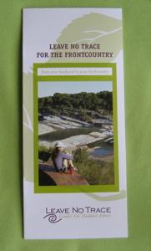

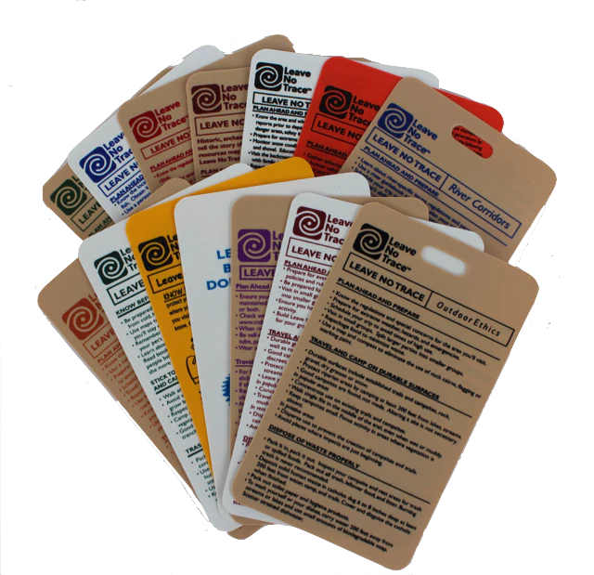
Resources from Leave No Trace
Pamphlets & Brochures
Principles Trifold
Pocket Guide
Frontcountry Guide Brochure
Group Use Brochure (PDF)
Mountaineering Brochure
Ethics Reference Cards (Hang Tags)

Slide 7


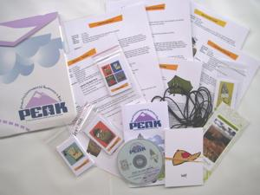

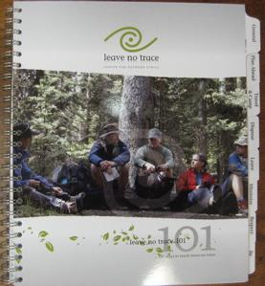
Resources from Leave No Trace
Activity Guides
101 Ways to Teach Leave No Trace
Teaching Leave No Trace: Activity Guide
Leave No Trace Skills and Ethics Guide
PEAK Pack Vol. 2
PEAK Pack Additional Modules
Bigfoot’s Playbook

Slide 8






Resources from Leave No Trace
Books
Leave No Trace in the Outdoors
BACKPACKER Leave No Trace
Soft Paths
Walking Softly in the Wilderness
Wilderness Ethics
Leave No Trace

Slide 9

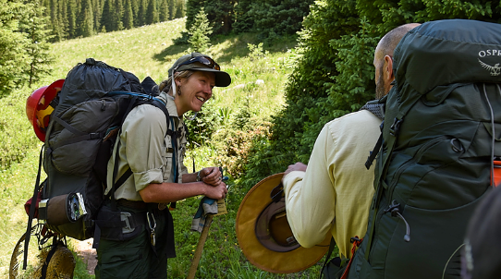
Resources from Leave No Trace Online Courses
Leave No Trace 101
Leave No Trace Backcountry
Introduction to Effective Communication of Leave No Trace
Leave No Trace Stock Use
PEAK Online
Zero Landfill
Leave No Trace for Elopement Photographers
Level 2 Instructor Refresher
Teaching Resources Page

Slide 10
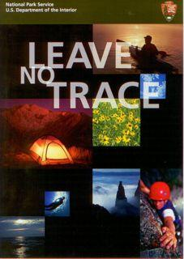
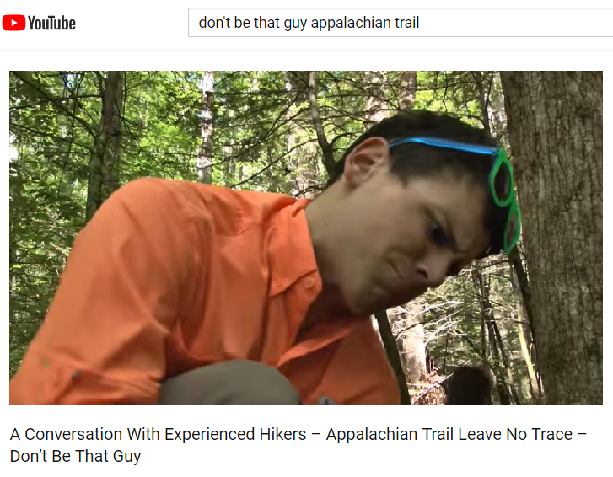
Resources from Leave No Trace
Video
Leave No Trace Center YouTube Channel
National Park Service Leave No Trace DVD
Appalachian Trail Conservancy “Don’t be That Guy”

Slide 11

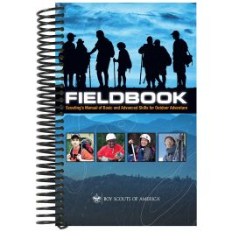


Resources from Scouting America
Printed Material
Training
Scouting.org and Scouting-OEC.org/resources
Outdoor Ethics Awareness Award Brochures
Networking
Virtual Roundtables

Slide 12
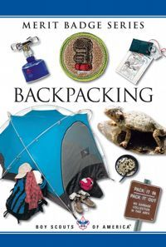
Resources from Scouting America
Printed Material
Scout Handbook
Fieldbook
Teaching Leave No Trace (web page & downloadable)
OE Award Brochures
Merit Badge pamphlets
Notes:
Merit badge pamphlets are available for free download at: https://www.scouting.org/skills/merit-badges/all/

Slide 13
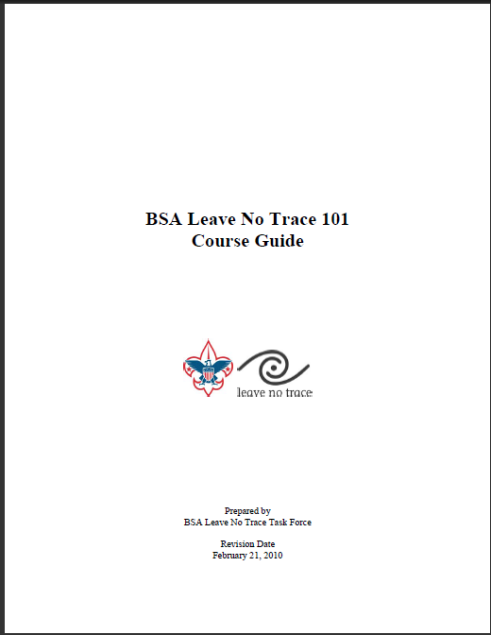
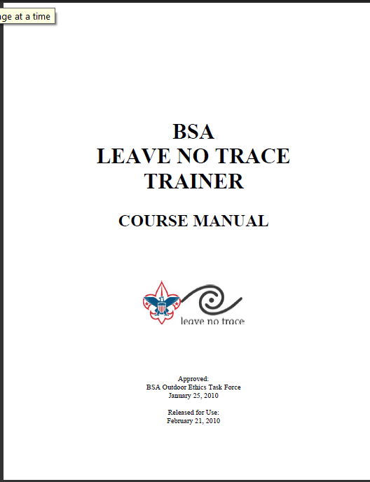
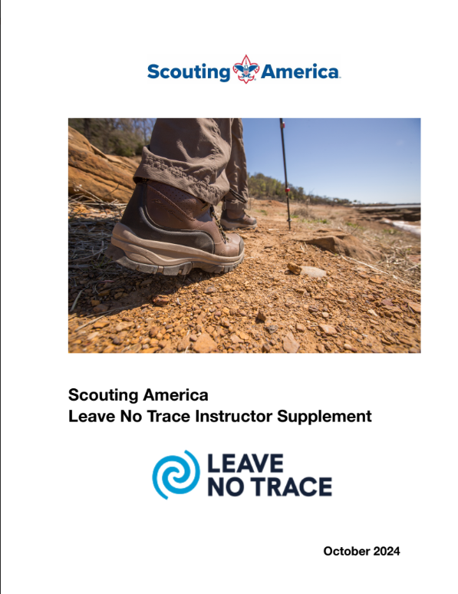

Resources from Scouting America
Scouting America Training
Outdoor Ethics Orientation
Leave No Trace Basics
Leave No Trace Level 1 Instructor Course
Leave No Trace Level 2 Instructor Course
Implementing Outdoor Ethics in your Unit, District, and Council
Leader Specific training
Basic Adult Leader Outdoor Orientation (BALOO)
Introduction to Outdoor Leader Skills (IOLS)
Wood Badge

Slide 14
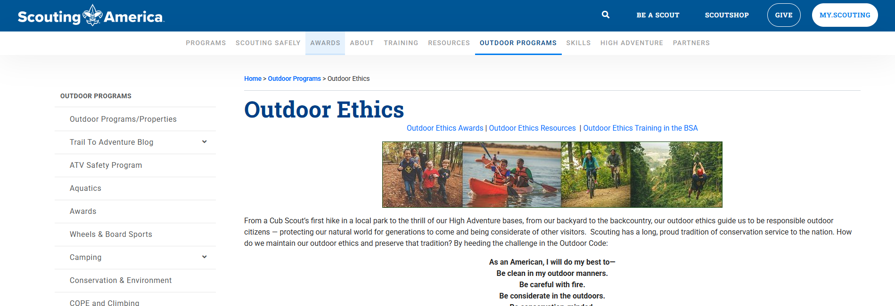

Resources from Scouting America
Scouting America Websites
Scouting.org
https://www.scouting.org/outdoor-programs/outdoor-ethics/
Scouting.org Outdoor Ethics Resources
https://www.scouting.org/outdoor-programs/outdoor-ethics/resources
Outdoor Ethics Resources
http://Scouting-OEC.org/

Slide 15
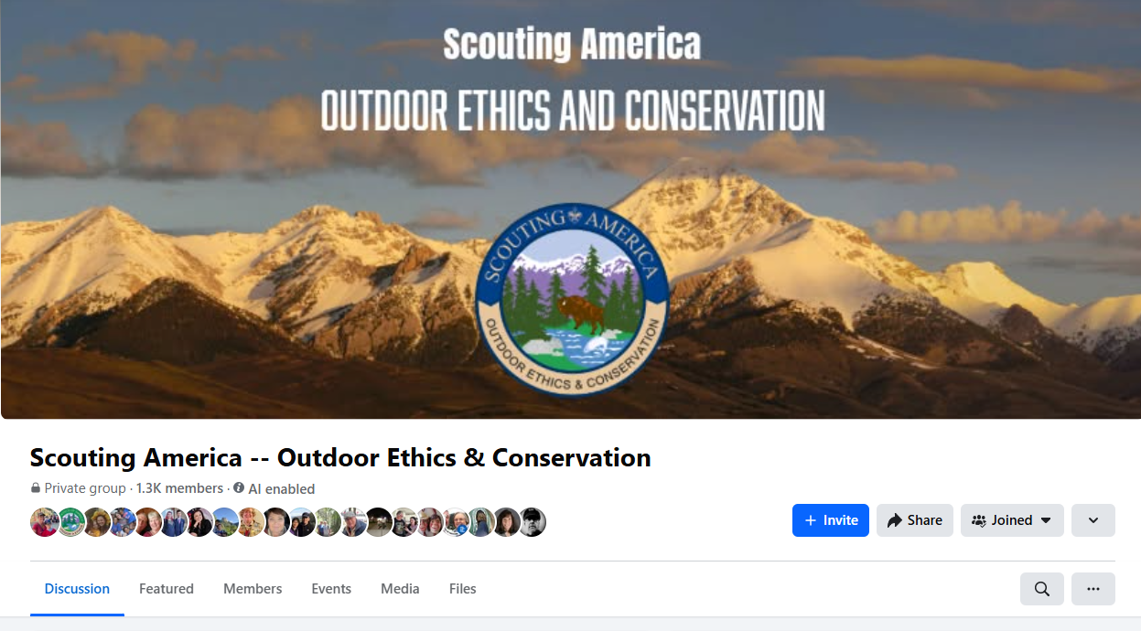
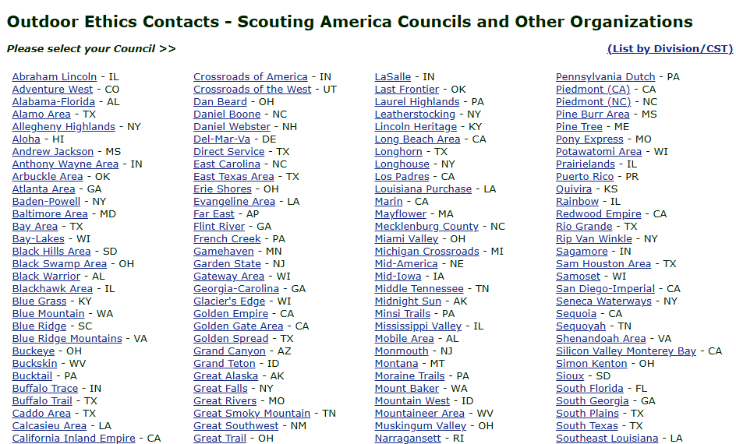
Resources from Scouting America
Networking
Social Media
Scouting America’s Outdoor Ethics and Conservation Facebook Page
OE&C YouTube page
OE Contacts in Councils
Council Outdoor Ethics Advocate
Level 2 Instructors

Slide 16
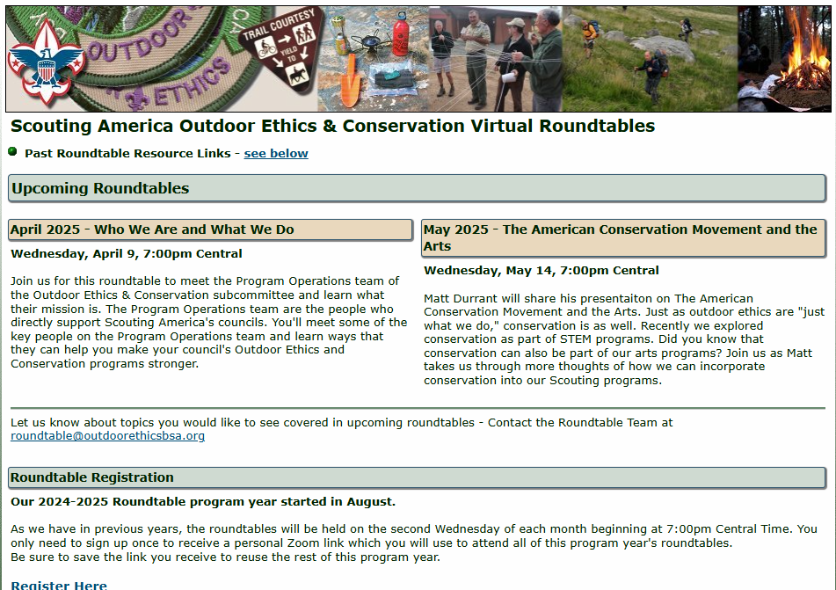
Resources from Scouting America
Virtual Roundtables
Held Monthly via Zoom
Topics have included:
Interpretation
Conservation at High Adventure Bases
Understanding Land Management
Using Meals for Hands on Learning
The Land Ethic
Women: Doing outside what we do inside
Info/Register/Archive at Scouting-OEC.org/roundtable
Notes:
The archive contains all the presentations and resources from past roundtables.

Slide 17
Resources from Scouting America
Past Outdoor Ethics & Conservation Conference Archive
Scouting-OEC.org/resources/moreResources.php
OE Training Resources
Scouting-OEC.org/resources
Calendar of OE Training Events
Scouting-OEC.org/calendar
Notes:
The archive contains recordings of presentations and resources from past Outdoor Ethics and Conservation Conferences

Slide 18
Scouting America
Leave No Trace Instructor Course

Slide 19
Prepared by
Joshua Lamothe
Revised: April 2025
Sources:
lnt.org
Scouting-OEC.org/news

